Slide 1
Splunk
The Data-to-Everything Platform
장경운 팀장
Splunk Korea
2020.07
Notes:
Key Takeaways
-Welcome and Thank You
-Introduce the theme of business outcomes
-We are here to help you drive business outcomes
Talk Track
Thank you so much for having me here today. My name is_____ and I’m here to share with you our vision for the future of data and get feedback from you on how we can help you make the most of one of your most precious resources.
At Splunk we have an overarching mission not just to help you see the data in your organization, but most importantly to turn it into business outcomes. Actionable outputs that are relevant, timely and can drive the growth of your business. That’s what turning data into doing is all about.

Slide 2
Notes:
Key Takeaways
- You should base your purchasing decision on the most current available technology
Talk Track
Before we begin, just wanted to quickly note that while we may talk about products are features that may become available in the future, you should base your purchasing decisions on the most current available technology.

Slide 3

Splunk Company Overview
Global HQs
San Francisco
London
Hong Kong
NASDAQ:
SPLK
4,000+
Employees Globally
Annual Revenue
$1.25B+
16,000+
Customers
89 of the Fortune 100
Rely on Splunk
Customers Range From Small Businesses to
Large Organizations
Across
110+
Countries
Splunk4Good
$100 Million Commitment to Support Nonprofits, Research & Education
Largest License:
4+Petabytes/day
Notes:
We have accomplished a lot since our company’s founding in 2003.
We were the first big data company to go public. Today, we have customers in 110 countries. 89 of the Fortune 100 are our customers.
You have a huge opportunity in front of you.
We are looking forward to working with you to ask tough questions, and get actionable answers from your machine data.

Slide 4


© 2019 SPLUNK INC.
Every Company Has a Universe of Real-time Data
New Data
Streams &
Devices
Sensor
Data
Creating More Opportunities and Threats than Ever Before
Network
Logs
Proxy
Data
New Apps &
App Logs
Firewall
Logs
Database
Logs
Transaction
Data
Operating
Systems
New
Technology
* Idc- Data Age 2025: The Digitization Of The World- November 2018

Slide 5



Data
Silos
Point Data Management
Solutions
Turning
Real-time Data Into Action
is Hard
Data
Lakes
ETL
Master Data Management
© 2019 SPLUNK INC.
Notes:
Key Takeaways
-Turning data into real-time action is hard
-Traditional approaches can’t keep up with Increasing volume, variety, velocity of data means
Talk Track
Organizations of all sizes have told us that they see the potential value in this real-time data, but turning it into action is incredibly difficult. The solution that’s been offered to most of us is that you can structure your way out of the problem. But even with a massive budget, integration tools, business process maps, and a team of data or database experts, the increasing volume, speed and variety of data sources make it increasingly difficult to make headway.
This is why so many of the promises of big data just haven’t been realized.
At Splunk our approach is different. We allow you to ingest data from all kinds of different sources: Be it systems, devices or interactions, and turn that data into meaningful business outcomes across your organization.
That’s the power of Splunk. Let’s take a quick look at how…
​

Slide 6

© 2019 SPLUNK INC.
IT
Point Data Management
Solutions
Turning
Real-time Data Into Action
is Hard
Master Data Management
Security
Data
Lakes
The
Data-to-Everything Platform
ETL
Data
Silos
IoT
Biz Analytics
Notes:
Key Takeaways
Splunk is the Data-to-Everything Platform designed to unlock trapped value by bringing data to every question, decision and action
Splunk helps every part of your organization be more data-driven
Talk Track
At Splunk we have created the world’s first Data-to-Everything Platform to remove the barriers between data and action so that people and businesses can turn data into doing. When we say “everything” we mean that we’re here to bring data to every question, every decision and every action. In short, we’re here to bring data to every business outcome.
This expanded vision includes IT and security as well as an expanded set of use cases for IOT and business use cases. Our customers are coming to us with use cases we could have never dreamed.
That’s the power of Splunk. Let’s take a quick look at how…
​

Slide 7
© 2019 SPLUNK INC.
ACT
Turning Real-time Data Into Action
is Hard
IT
Point Data Management
Solutions
Master Data Management
Any Structure
Any Source
Any Time Scale
Security
Data
Lakes
ETL
Data
Silos
ANALYZE
INVESTIGATE
IoT
Biz Analytics
MONITOR
Notes:
Key Takeaways
Data is only valuable if you’re able to act on it
Splunk has a complete portfolio that allows you to go from investigation and monitoring to analysis and action.
Everyone in your organizations needs to be able to investigate, monitor, analyze and act on their data
Talk Track
We want to help the world ACT on their data. In order to do that you need holistic solutions that help you investigate, monitor, and analyze it.
Everyone in your organization needs to be able to investigate, monitor, analyze and act on their data.
And we not only have the only Platform that brings all of these capabilities together, but we also have the only platform that is prepared for the data challenges of the future:
The D2E platform can handle ANY STRUCTURE. From the most unstructured to the most highly structured. From the most rapidly incoming events to more static business data.
ANY SOURCE - We can unlock previously inaccessible value by understanding the relationships between data stored throughout different databases and systems without having to be in Splunk. Because we know those systems are not going away.
ANY TIME SCALE - We can go from milliseconds to months, enabling systems and teams to analyze and respond to events over large amounts of time to answer business-critical questions.
Splunk is the only solution designed to handle all of these data challenge and help you bring data-based decisions and action to everything.
Customers are putting our D2E platform to work in amazing ways
​

Slide 8
Splunk: The Data-to-Everything Platform
Bring data to every question, decision and action
IT
Security
IoT
Biz Analytics
Cloud Monitoring
Application Lifecycle Analytics
Application Release Analytics
Container Monitoring
Infrastructure Monitoring
Advanced Threat Detection
Insider Threats
Incident Investigation and Forensics
SOC Automation
Compliance
Real-Time Monitoring and Diagnostics
ICS Security
Predictive Analytics
Facilities Management
Business Process Mining
Customer Experience Optimization
Incident Management
Digital Marketing Optimization
Notes:
Key Takeaways
Splunk is used across the enterprise from IT and Security to IOT and the line of business for a myriad of use cases
The list of use cases is nearly limitless
Talk Track
A variety of teams from organizations big and small rely on Splunk. While Splunk is best known for IT and Security use cases, industry leaders like Otto Group and Dominos Pizza have expanded into business analytics use cases. DB Cargo in Germany and Dubai Airports in the UAE use Splunk for IoT use cases.
If you can think of a use case for real-time date, Splunk and our ecosystem of partners can help you. ]

Slide 9
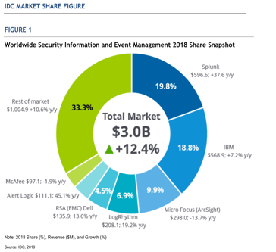
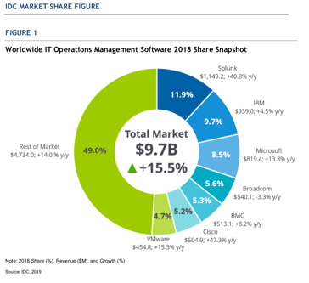
Splunk #1 in IDC WW SIEM & ITOM Market Share 2018
19.8% Share in SIEM 2018 Market, 11.9% Share in ITOM 2018 Market
Source: Worldwide Security Information and Event Management Market Shares, 2018: By Size of Business — The Attempt to Serve All Client Needs Chris Kissel, Frank Dickson; June 2019.
Source: Worldwide IT Operations Management Software Market Shares, 2018: Monitoring, Log Analytics, Hybrid IT Drive Strong Growth, Tim Grieser, Stephen Elliott; June 2019.

Slide 10








Splunk Data-to-Everything Platform
프리미엄 솔루션
풍부한 앱 생태계
SOAR
ITSI
SFx
BF
Security
Phantom
IT Monitoring
VMware
SignalFx
Business Flow
Machine Learning
Connected Experiences (Web, iOS, Android, TV, AR, VR)
Platform for Machine Data
Forwarders
Syslog /
TCP / Other
Wire
Data
Relational
Databases
Mobile
Sensors & Control Systems
Mainframe
Data
Notes:
The Splunk platform consists of multiple products and deployment models to fit your needs.
Splunk Enterprise – for on-premise deployment
Splunk Cloud – Fully managed service with 100% SLA and all the capabilities of Splunk Enterprise…in the Cloud
Hunk – for analytics on data in Hadoop
Splunk MINT – to get insights into data from Mobile devices
The products can pull in data from virtually any source to support multiple use cases.
Splunk Apps extend and simplify deployments by providing pre-packaged content designed for specific use cases and data types.

Slide 11





SPLUNK is different
!!!
Machine Generated Data
CDR >
Packets >
Sensor data >
Security data >
Log files >
Server Status >
Virtualization Mgmt >
Application Monitoring >
Web Logs >
Transaction Data >
Scripts >
Metrics >
Configuration Data >
✔
Ad-hoc Search
Chart
Dashboard
Alert
Adaptor?
E.T.L?
DB Schema?
DB Mgmt?
Limit?
✔
New Data Source >
New Data Source >
New Data Source >
Forwarder

Slide 12


머신데이터 분석 환경의 새로운 패러다임
SCHEMA AT WRITE
SCHEMA AT READ
30 YEARS
NEXT 15 YEARS+
Ecosystem
~$100Bn
Next Gen Analytics Ecosystem
어플리케이션
ERP, CRM, SFA, etc
IT운영, 보안 관제
사용자/서비스 분석
??
쿼리 언어
SQL
Search
??
데이터 저장소
??
RDBMS
Notes:
So what is that meant for the industry. Think about the Analytics Ecosystem. You have the data fabric that you put data into. Then you have the Query Language sitting on top of that you extract value out of it. And there are certain Applications that you can built on top. For the last 30 years, we were doing schema at write. So what was originally the first data fabric –The Database. 30 years ago, there were a bunch of datastore if you have more gray hair than me you probably would remember. And then DATABASE came along and standardized the data fabric and then we can all put data into it. Then a language – SQL was then invented and became a standard. There was the time when every vendor implemented SQL in their own database that logged into their platform.
But as a query language, it really help because what it did was it helped the explosion in the industry of development of applications. I think you all probably have Oracle somewhere in your environment. But the biggest contribution of Oracle that ever gain to the World is PL SQL. Because what they do is to have a bunch of people that built application close to the data on top of the data. Those are the things that happened over the last 30 years, and of course they didn’t happen on day one.
That created a huge ecosystem. Right now if you talk to an IDC analyst, they will tell you somewhere around $100B value created over the 30 years, that’s huge!
We are going through this change as I mentioned. We are going to schema at read and I think its a move that that is probably going to take 15 years to play out in the industry?! We are very very early in the curve of maturity now as in the schema at read – I think!
So I don’t think it will take another 30 years because in many ways we have seen how it played out in the traditional world and companies know where to fit in. So probably will go faster but this kind of infrastructure change still takes time. Its not something that can be done in 3 or 4 years but more like a generational change. So, there will be a new ecosystem and there will be things that fit into that gap. So what could be like the apps? Some of these apps I have seen in the big data world that comes with a killer patent is Security. There are tons of different information that come from security systems. So there you see a lot of companies are building security solutions from all of the big data.
I already told you about the query language. I believe the query language is “SEARCH” as oppose to “SQL” so you could probably guess what is coming next!
I think the next generation data fabric will be Splunk!

Slide 13
Machine data requirements
Dev Ops
IT Ops
Development & Test
Code Release
Production Support
Reporting and Analytics
Development
Security & Compliance
Security
Operation
Monitoring
Incident management
Problem management
Capacity planning
Monitoring/Alerting
Incident Management
CSIRT
Compliance/Posture

Slide 14



DevOps
Application
Silo 없는 단일 OI 플랫폼
WEB
Middleware
Schema on the fly
Database
IT Ops
Virtualization
Universal machine data platform
OS
end-to-end realtime architecture
Compute
Scale from desktop to enterprise
Storage
Security & Compliance
Network
Passionate community
Threat Intelligence
Fast time to value
Access Identity
Endpoints

Slide 15








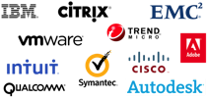


전 세계 110+개 국가 16,000+ 고객
Cloud and Online Services
Education
Energy and Utilities
Financial Services and Insurance
Government
Healthcare
Manufacturing
Media
Retail
Technology
Telecommunications
Travel and Leisure
Notes:
More than 6,000 users in over 90 countries have purchased the enterprise license of Splunk. This includes a majority of the Fortune 100.
Enterprises, service providers and government agencies in 90 countries use Splunk to improve service levels, reduce IT operations costs, mitigate security risks and drive new levels of operational visibility.
As they gain new visibility into their real-time and historical machine data, Splunk’s customers are finding answers and solving the most challenging issues facing IT and the business.

Slide 16
Customer Quotes
“3일만에 Amazon AWS 데이터 수집이 끝났어요.
이런 프로젝트는 처음 봅니다.”
- 국내 D고객, Project Kickoff 미팅
“Splunk는 우리 조직에서 하나의 공통 언어입니다.
데이터를 보려고 운영 서버에 접속하는 일이 없어지면서
사람의 실수로 인한 장애가 눈에 띄게 줄었어요.”
- 국내 S사 고객
“이제는 월말 DW 정산이 끝날때 까지 기다리지 않아도
마케팅 이벤트 효과를 즉시 알고 수정할 수 있어요.”
- 국내 C고객
“Splunk에 데이터를 보내지 않는 서버는
받을 수 없습니다.”
- 해외 A 고객, Datacenter

Slide 17
Pains that you may have in …
Agility
  모니터링 대상 시스템의 잦은 변경
  데이터 종류 및 포멧의 다양성
  새로운 분석 요구 사항 지원
Variety in usages
  어떤 분석을 하게될지 아직 모른다는 점
Performance and Scalability
  수집/보관 만이 문제가 아니다. 다수 사용자의 다양한 데이터 활용을 어떻게 지원할 것인가?
  지속적인 확장
How to share the insights across organization
  어떻게 수집된 데이터를 유기적으로 활용되도록 할 것인가?
  조직내 여러 그룹의 데이터 활용 성숙 과정을 어떻게 지원 할 것인가?

Slide 20
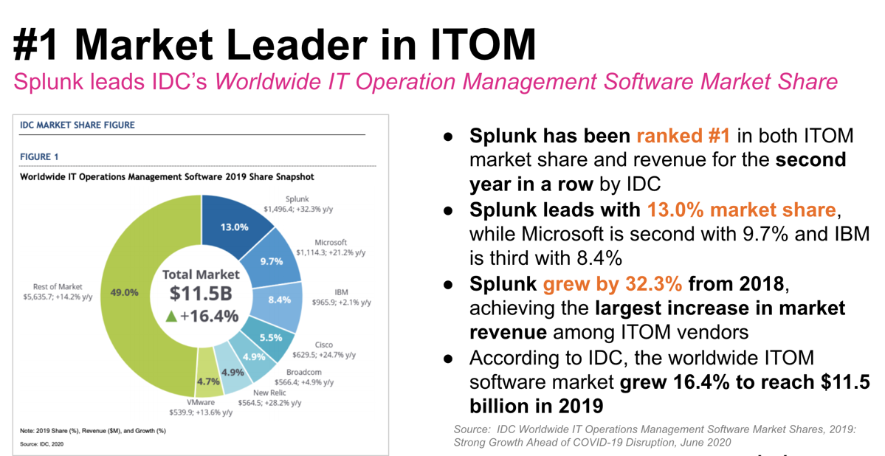

Slide 21
